Slide 1



Sequential Convex Programming for Stochastic Multi-agent Systems with connectivity constraints
Aman Tiwary

Slide 2
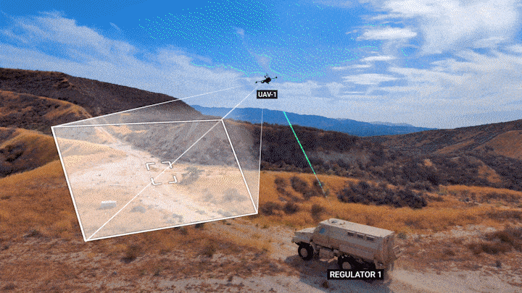

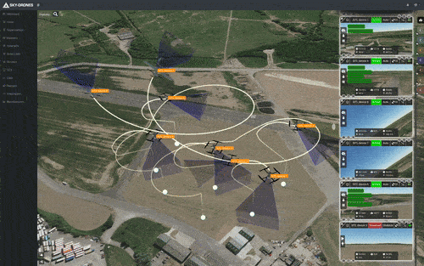
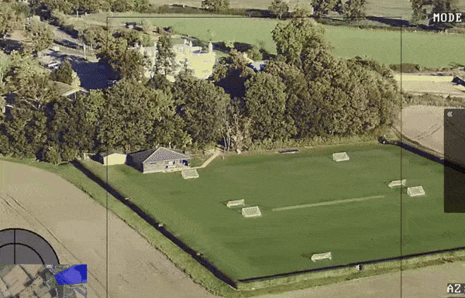
Motivation
Surveillance*
Inspection*
Search
And
Rescue**
*Skydio - https://www.skydio.com/blog
** Sky-Drones - https://sky-drones.com/swarm

Slide 3
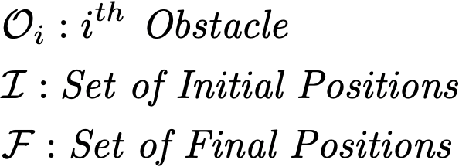






Problem Statement
time

Slide 4
Problem Statement
time

Slide 5
Problem Statement
time

Slide 6
Problem Statement
time

Slide 7

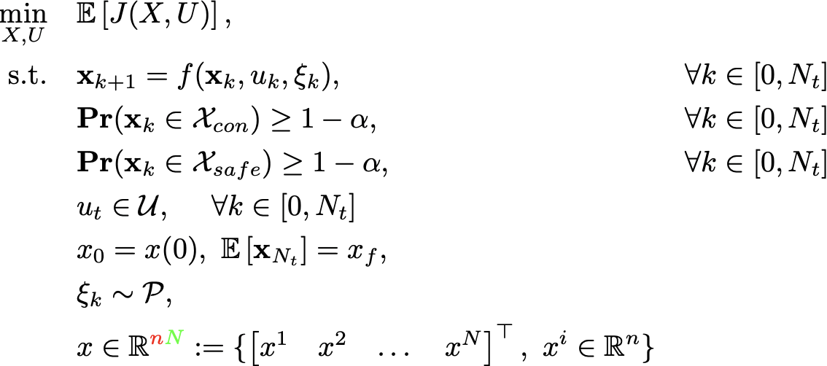
Stochastic Optimal Control Problem
Connectivity constraints
Collision Avoidance
# Agents
States

Slide 8

Challenges
Connectivity Constraints
Binary variable that stores connectivity information
Mixed Integer Formulation -> exponential scaling
Computationally
Intractable!!
Stochastic Disturbances
Chance Constraints with probability
Nonconvex & computationally intractable

Slide 9
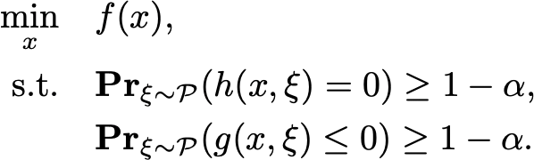
Contribution
Scenario Approximation of chance constraint
tolerance
Feasible set can be Nonconvex
Even when convex, difficult to compute

Slide 10
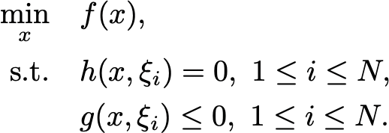
Contribution
Scenario Approximation of chance constraint
tolerance
Feasible set can be Nonconvex
Even when convex, difficult to compute
Scenario Reformulation
Sampled from distribution
Devonport and Arcak, “Estimating Reachable sets with Scenario Optimization”, L4DC (2020)

Slide 11

Contribution
Scenario Approximation of chance constraint
tolerance
Feasible set can be Nonconvex
Even when convex, difficult to compute
Scenario Reformulation
Sampled from distribution
Devonport and Arcak, “Estimating Reachable sets with Scenario Optimization”, L4DC (2020)

Slide 12
Contribution
Scenario Approximation of chance constraint
tolerance
Feasible set can be Nonconvex
Even when convex, difficult to compute
Scenario Reformulation
Sampled from distribution
Accuracy
Devonport and Arcak, “Estimating Reachable sets with Scenario Optimization”, L4DC (2020)

Slide 13
Contribution
Scenario Approximation of chance constraint
tolerance
Feasible set can be Nonconvex
Even when convex, difficult to compute
Scenario Reformulation
Sampled from distribution
Accuracy
Confidence
Devonport and Arcak, “Estimating Reachable sets with Scenario Optimization”, L4DC (2020)

Slide 14


Contribution
Integer constraint reformulation via complementarity
Constraint Jacobian Rank Deficient
Violates LICQ and MFCQ

Slide 15
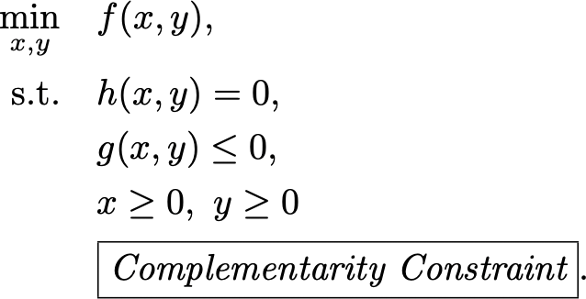


Contribution
Integer constraint reformulation via complementarity
Constraint Jacobian Rank Deficient
Violates LICQ and MFCQ
Solution Strategies
1.
2.
3.
4.

Slide 16
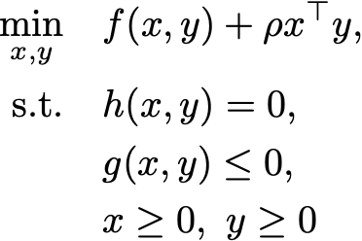
Contribution
Integer constraint reformulation via complementarity
Constraint Jacobian Rank Deficient
Violates LICQ and MFCQ
Solution Strategies
Penalization of complementarity constraint

Slide 17
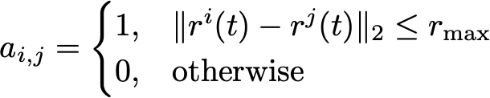
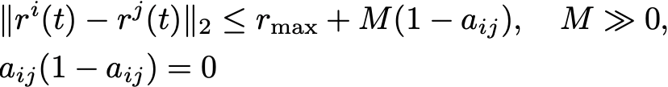



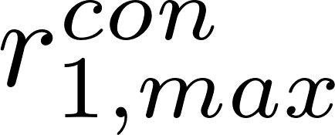

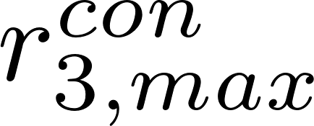
Formulation: Connectivity Constraint
Connectivity Variable
Communication range of A₁
Communication range of A₃

Slide 18

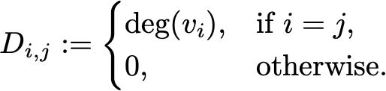
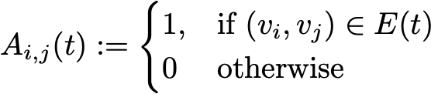



Formulation: Connectivity Constraint
Given a graph G(V, E) with |V| = n, the graph G is connected if and only if the second eigenvalue of its Laplacian is strictly positive
Connected Graph

Slide 19

Future Work
1. Connectivity Under Stochastic Dynamics
Connectivity is proximity-based → becomes a random variable under stochastic motion
Characterize the distribution of the connectivity variable $a_{ij}$
Understand the level sets of chance-constrained connectivity conditions – Can they be convexified or approximated?
2. Probabilistic Graph Connectivity
Treat connectivity as a deterministic variable with probabilistic edges
e.g., edge $\left(i , j\right)$exists with probability $p_{ij}≈0.95$
Use random graph theory to derive bounds on: – Probability of global connectivity – Conditions for maintaining a connected graph with high probability
3. Toward a Full Stochastic MAS Solver
Combine scenario-based uncertainty treatment with connectivity reformulation
Develop scalable algorithms for the stochastic multi-agent connectivity problem

Slide 20

Acknowledgements
Collaborators
Dr. Dan Calderone and Dr. Rosalyn Devonport, University of New Mexico
Samet Uzun and Dr. Behçet Açıkmeşe, University of Washington
This work is supported by AFOSR under grant FA9550-23-1-0646.

Slide 21
THANK YOU !!

Slide 22
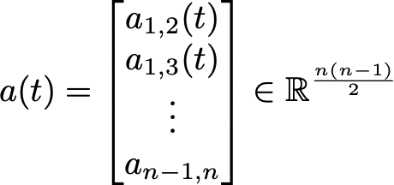
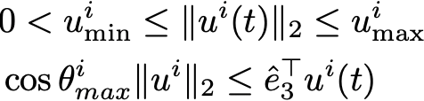

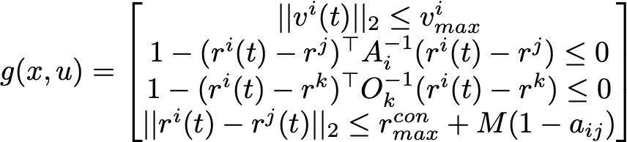
Formulation
Control Augmentation
Control Constraints
Path Constraints

Slide 23
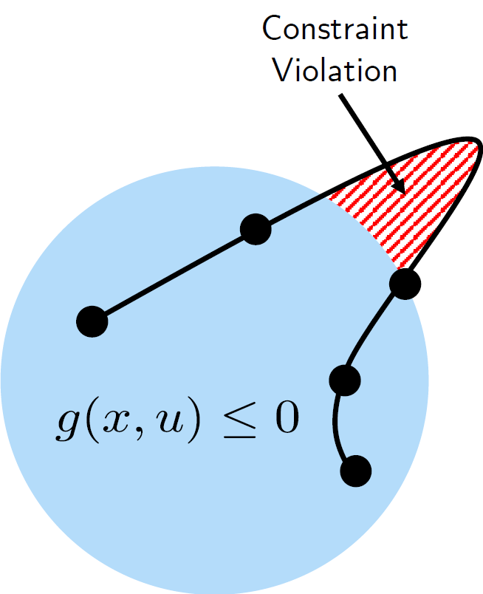
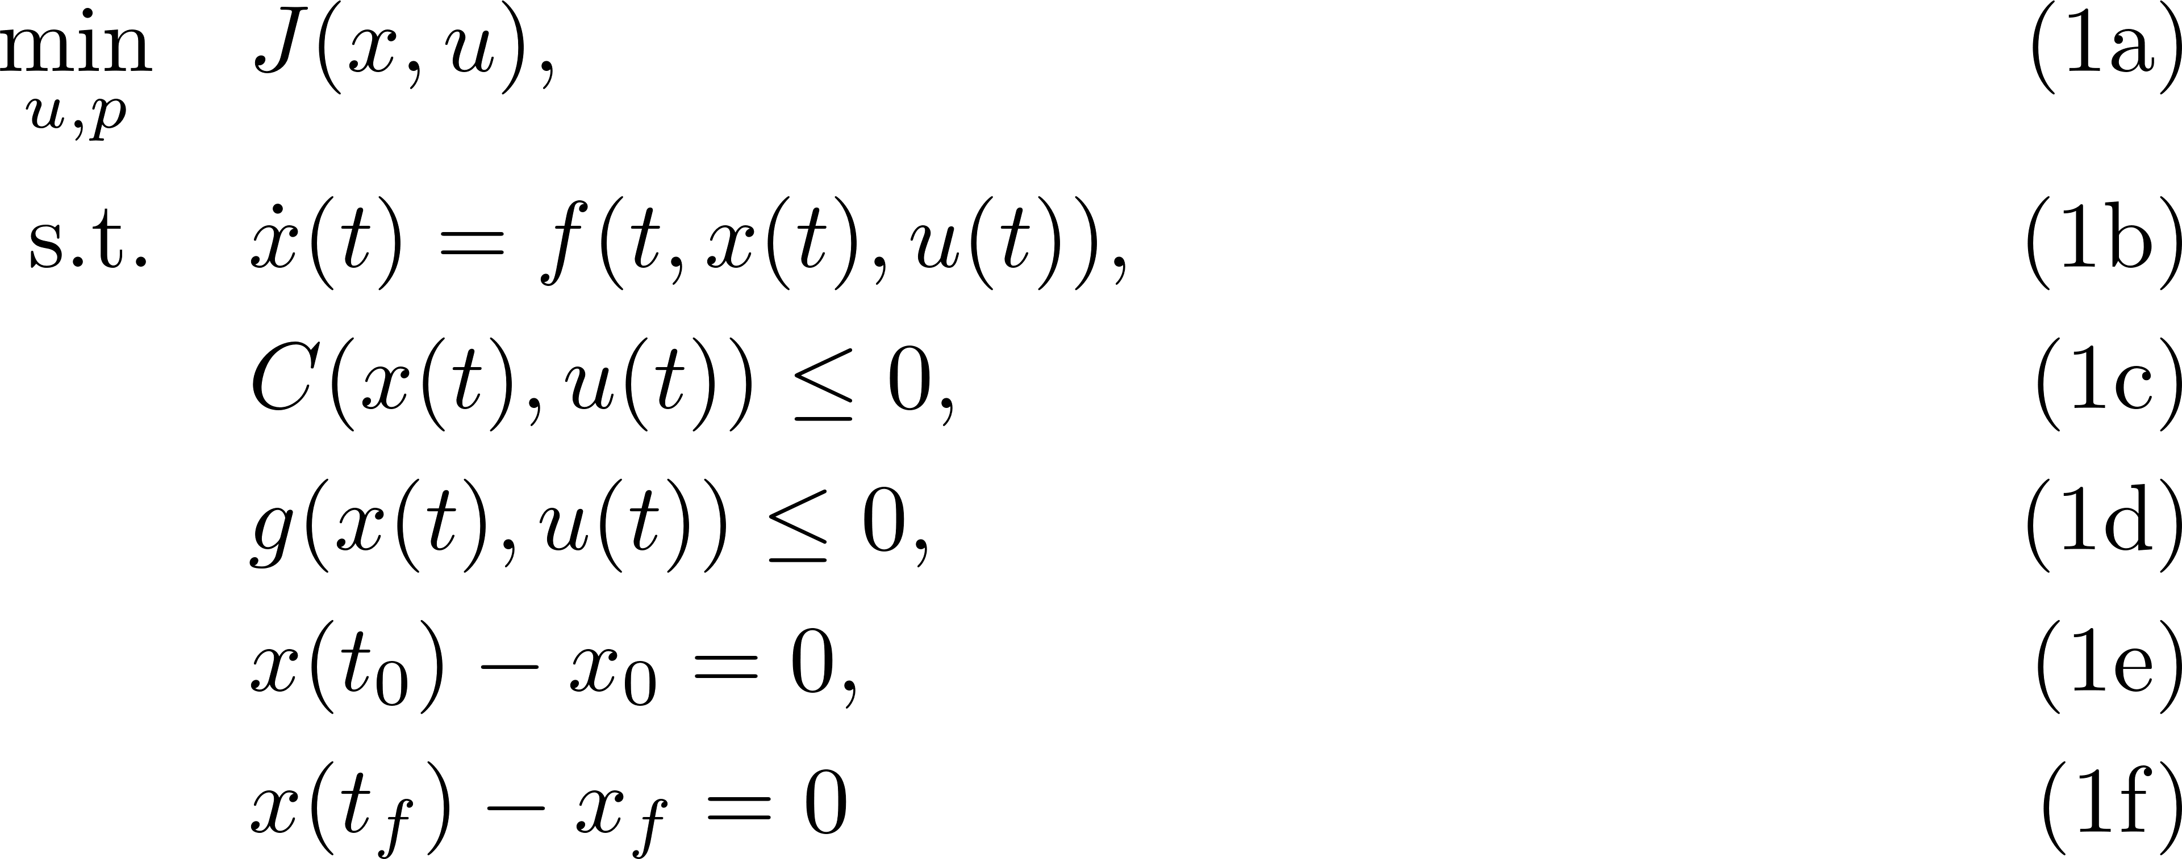
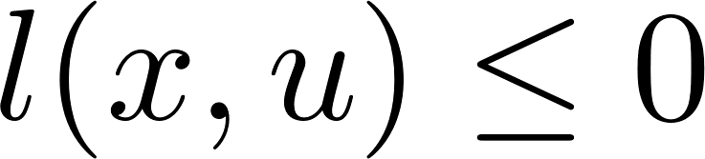
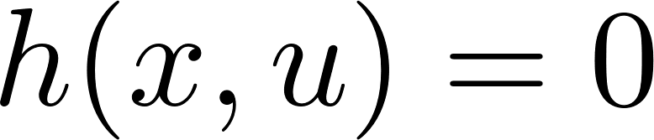
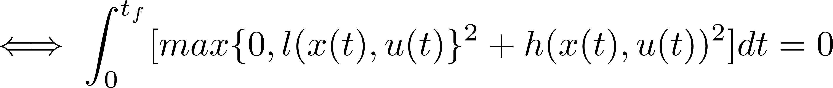
Solution Approach: CT-SCvx
Optimal Control Problem
Constraint Reformulation
*Purnanand Elango, Dayou Luo, Abhinav G. Kamath, Samet Uzun, Taewan Kim,and Behcet Acıkmese. Successive convexification for trajectory optimization with continuous-time constraint satisfaction, 2024.

Slide 24
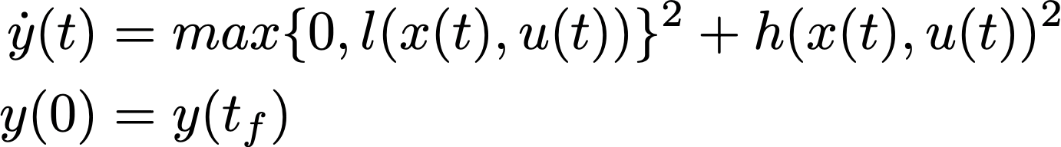
Solution Approach: CT-SCvx
Optimal Control Problem
Constraint Reformulation
*Purnanand Elango, Dayou Luo, Abhinav G. Kamath, Samet Uzun, Taewan Kim,and Behcet Acıkmese. Successive convexification for trajectory optimization with continuous-time constraint satisfaction, 2024.

Slide 25
Solution Approach: CT-SCvx
Optimal Control Problem
Constraint Reformulation
*Purnanand Elango, Dayou Luo, Abhinav G. Kamath, Samet Uzun, Taewan Kim,and Behcet Acıkmese. Successive convexification for trajectory optimization with continuous-time constraint satisfaction, 2024.

